Slide 1
Intersection Problem
Traffic flow comparison of roundabouts with crossroads controlled by traffic lights, including pedestrians
Marcel Arikan, Nuhro Ego, Ralf Kohrt
HS 2012
© ETH Zürich |
Notes:
18.12.12
1

Slide 2
Abstract
Cellular Automata
Nagel-Schreckenberg
Parameters: car and pedestrian density
Roundabouts are up to 2x more efficient than crossroads, but collapse at high pedestrian densities
2
Notes:
18.12.12
2

Slide 3
Introduction and Motivation
Development of “Traffic Dynamics” by Tony Wood and Bastian Bücheler in May 2010
Added pedestrians and traffic lights, instead of “priority to the right”-organisation
From daily life experience: roundabouts have disadvantages!
3

Slide 4
Main Loop
One can set up an arbitrary combination of roundabouts (=0) and crossroads (=1) in a NxM matrix
The Inputs/Options are:
The Map
Pedestrian densitiy (can be given as an array) 0<x<1
Car density (can be given as an array)
Probability for a car to drive ahead
Wheather you want to view the simulation,create a video, view the simulation in slowmotion, store the simulation results for later plotting
4
Notes:
18.12.12
4

Slide 5
Main Loop
The simulation will give you a 3D plot over the densities and the trafficflow = average speed * car density
Execution:
traffic.m is our main function, which needs no input, but will ask for user inputs to use for the simulation
traffic.m will call trafficloop.m to start trafficsim.m for every density you set up seperately
trafficsim.m is our actual simulation loop which will make 1000 iteration steps and generate all the matrices and results using other functions
5
Notes:
18.12.12
5

Slide 6
Roundabout
Consists of 12 cells for the loop and 4 roads with pedestrian crossings
Pedestrians have priority over cars if the road is free
Cars inside the roundabout have priority over cars outside
Car speed is limited to 1 cell per iteration step
The exit a car will take is computed according to the probabily for cars going ahead
6
Notes:
18.12.12
6

Slide 7
Roundabout - Implementation
We are using many arrays to calculate the next timestep in the roundabout.m function
3 for the circle of the roundabout
8 pedestrian 'buckets'
The roundabout.m function handels 8 cells of each incoming/outgoing lane and all the cars inside the circle
7
Notes:
18.12.12
7

Slide 8
Summary
Roundabouts are much more efficient by low pedestrian densities and crossroads are more efficient by high pedestrian densities – so the increasing use in our cities is reasonable
Our result with low pedestrian densities is comparable to the results of Wood and Buecheler
8
Notes:
18.12.12
8

Slide 9
Outlook
The signalisation rules need to be optimized (which is clearly visible from the plots)
More intelligent traffic control could optimize our traffic lights
At high pedestrian densities one could control pedestrian crossings in front of roundabouts with traffic lights
9
Notes:
18.12.12
9

Slide 10
Crossroad with traffic lights (1)
Different signalisation dep. on pedestrian density
<0.3: pedestrians can block cars turning
0.3-0.6: pedestrians can block cars turning left
>0.6: pedestrians should no longer block
Input: probability for car driving ahead (pahead)
Probability of cars turning: (1-pahead)/2
Used to calculate the relative time for a light phase
For absolute time, multiply with phase length
10

Slide 11
Crossroad with traffic lights (2)
Control is not dynamic
For different crossroads: phase offset depending on car density
Nagel-Schreckenberg model in crossroad
Cars ahead: speed up to 5 cells per it.
Cars turning: speed up to 2 cells per it.
11

Slide 12
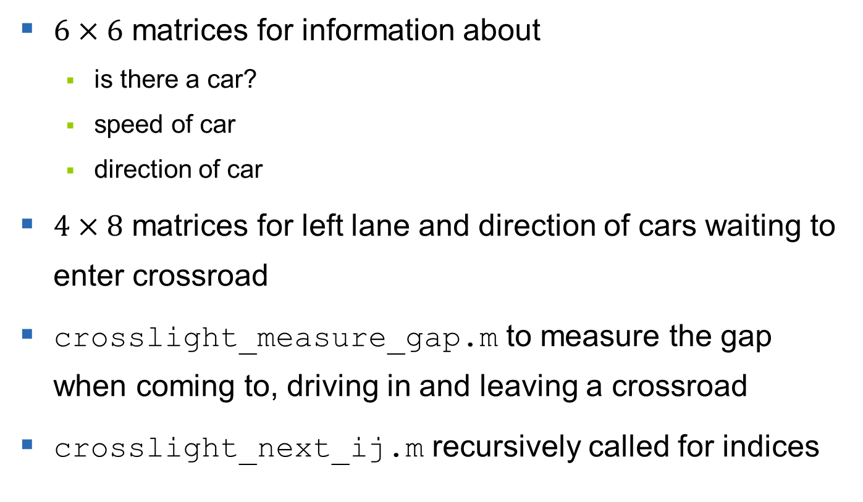
Implementation of crossroad
$6×6$ matrices for information about
is there a car?
speed of car
direction of car
$4×8$ matrices for left lane and direction of cars waiting to enter crossroad
crosslight_measure_gap.m to measure the gap when coming to, driving in and leaving a crossroad
crosslight_next_ij.m recursively called for indices
12

Slide 13
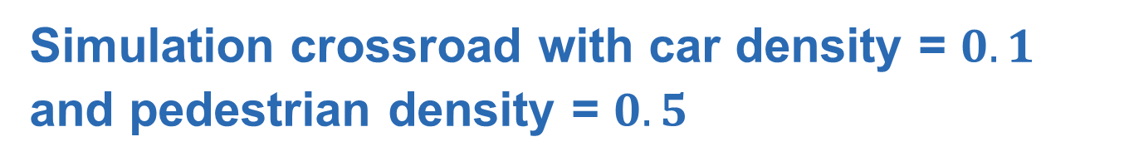
Simulation crossroad with car density = $0.1$ and pedestrian density = $0.5$
13

Slide 14
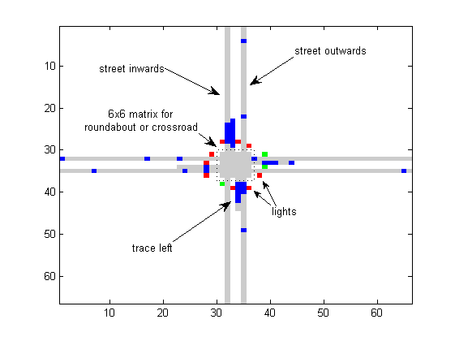
Implementation of crossroad
14

Slide 15
Graphical Implementation
bablb
15

Slide 16
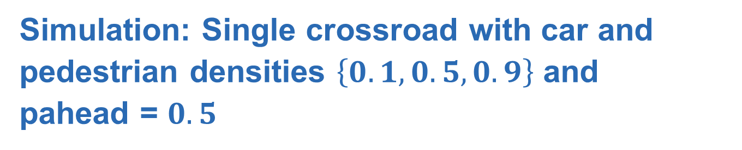
Simulation: Single crossroad with car and pedestrian densities $\left\{0.1, 0.5, 0.9\right\}$ and
pahead = $0.5$
16

Slide 17
Single Crossroad
Flow increases first with rising car density
Flow is constant within a signalisation mode → steps
Maximum low with flow = 0.23
Functional for all pedestrian densities
17

Slide 18
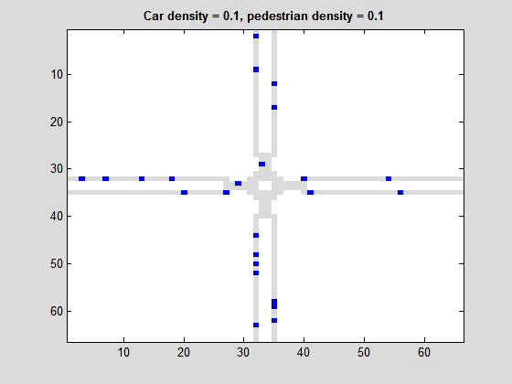
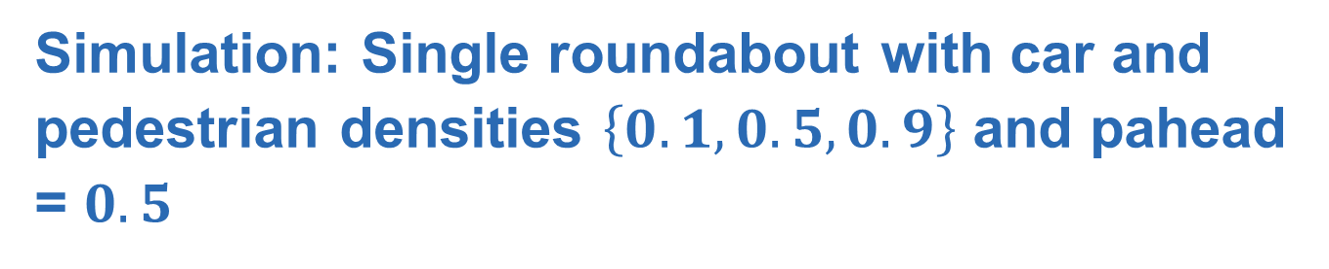
Simulation: Single roundabout with car and pedestrian densities $\left\{0.1, 0.5, 0.9\right\}$ and pahead = $0.5$
18

Slide 19
Single Roundabout
Linear decrease with increasing pedestrian density, independent of car density
Collapse at high pedestrian densities
Maximum high with flow = 0.38
If pedestrian density > 0.7, crossroad better
19

Slide 20
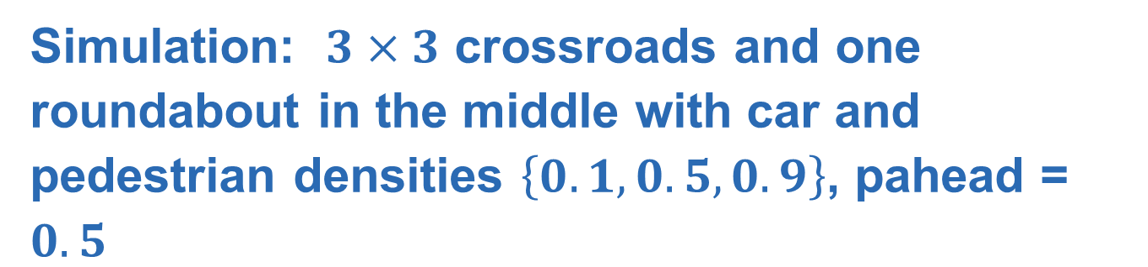
Simulation: $3×3$ crossroads and one roundabout in the middle with car and pedestrian densities $\left\{0.1, 0.5, 0.9\right\}$, pahead = $0.5$
20

Slide 21
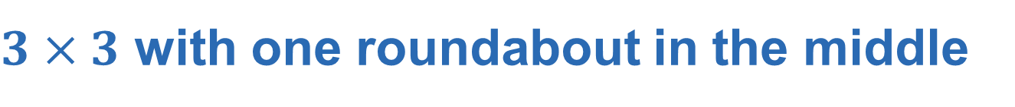
$3×3$ with one roundabout in the middle
At high car densities, surface is no longer smooth, pedestrian randomness appears
Dominated by the 8 crossrounds
At high pedestrian densities, roundabout gets blocked
Only a tiny overall improvement of the flow
21

Slide 22
Thank you for your attention.
QUESTIONS?
Notes:
18.12.12
22

Slide 23
References
Andreas Schadschneider, Michael Schreckenberg, Elmar Brockfeld, Robert Barlovic, Optimizing traffic lights in a cellular automaton model for city traffic,
Physical Review E, Volume 64s, 2001.
Bastian Bücheler, Tony Wood, Traffic flow comparison of roundabouts and crossroads, May 2010
Layout of presentation: Karsten Donnay, Stefano Balietti, Course Powerpoints, Modeling and Simulating Social Systems with MATLAB, 2012
23

